Slide 1

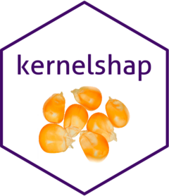
SHAP in R
github.com/mayer79/demo_shapviz

Slide 2
Miami House Prices
Data
14k observations
Response: log(price)
Features we will use:
center_dist
log_living
log_land
structure_quality
age
month_sold
Model
XGBoost
80% training rows
20% validation
Squared error loss
Could be improved

Slide 3
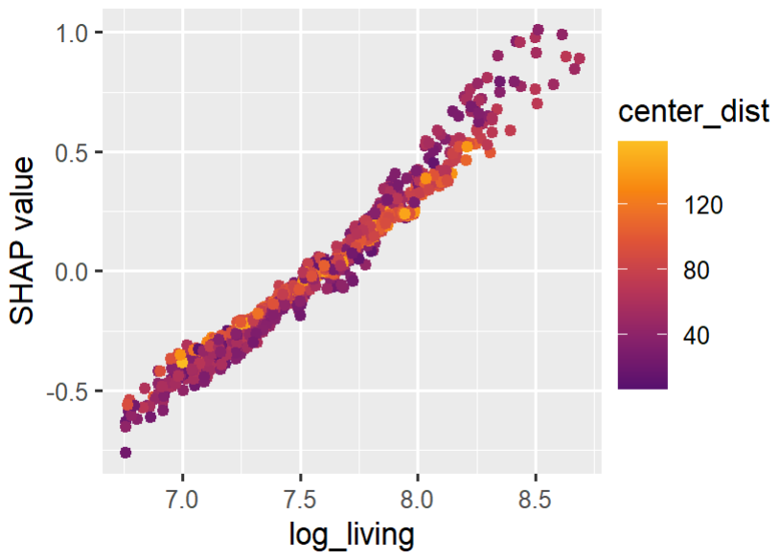
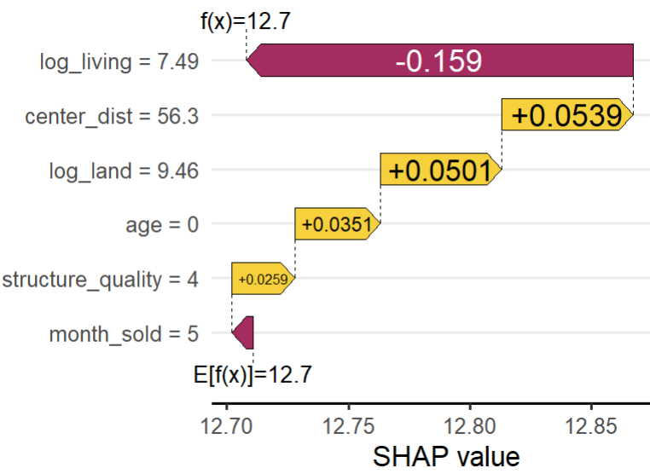
SHapley Additive exPlanations (Lundberg-Lee, 2017)
Decompose prediction fairly into contributions of the features
Repeat for many predictions to describe model
328k USD = prediction

Slide 4
Three Algorithms to Crunch SHAP Values
Tree-Based?
Yes
No
TreeSHAP
{xgboost}
{lightgbm}
{h2o}
{treeshap}
≤ 10 features
Yes
No
Permutation SHAP
kernelshap::permshap()
Kernel SHAP
kernelshap::kernelshap()
Very fast
Very good approximation

Slide 5






One Ring to Rule them all One Package to Plot them all: {shapviz}

Slide 6
{shapviz} API
data.frame-like with feature values
1. Initialize «shapviz» object
shap_values <- shapviz(object, X, …)
2. Use plot functions (ggplot2)
sv_importance(shap_values, …)
sv_dependence(shap_values, v = «carat»)
…
Matrix of SHAP values
Model: XGBoost/LightGBM/h2o-Booster, needs also X_pred
Output of {kernelshap}, {fastshap}, {treeshap}, {shapr}, …

Slide 7
Demo in R
https://github.com/mayer79/demo_shapviz

Slide 8
Things to Explore
SHAP interactions
Multivariate output (e.g., multi-class classification)
How do TreeSHAP, Permutation SHAP, Kernel SHAP work?
Feature construction is relevant: not too correlated features!
A SHAP analysis is as good or bad as your model!

Slide 9
Questions?

Slide 10
Resources
Slides and demo: https://github.com/mayer79/demo_shapviz
{shapviz}: https://github.com/ModelOriented/shapviz
{kernelshap}: https://github.com/ModelOriented/kernelshap
Python: https://github.com/shap/shap
Theory and code in R and Python: SHAP for Actuaries: Explain any Model (2023) Michael Mayer, Daniel Meier, and Mario V. Wüthrich http://dx.doi.org/10.2139/ssrn.4389797
Original SHAP paper: A unified approach to interpreting model predictions (2017) Scott Lundberg and Su-In Lee NIPS'17: Proceedings of the 31st International Conference on Neural Information Processing Systems

